Slide 1

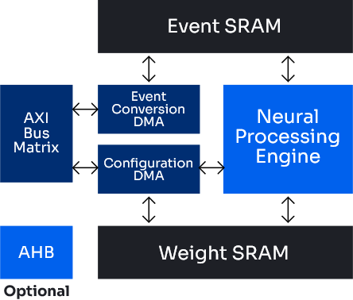




The AkidaTM Pico is an Edge AI acceleration co-processor or stand-alone core built on the Akida Event-based processing platform.
Akida Pico accelerates a set of highly optimized temporal event-based neural network models to create an ultra energy-efficient, and purely digital, event-based processing architecture. Akida Pico features built in capabilities to execute these networks without a host CPU, enabling stand-alone operation for always-on ultra-low power. BrainChip’s unique MetaTFTM software flow enables developers to compile and optimize their chosen models for the Akida Pico.
The Akida Pico can be paired to wake up an MCU or CPU via a low-power interrupt to create very compact, ultra-low-power, portable and intelligent devices for wearables, remote sensors, always on wake-up devices, Healthcare, Consumer, Smart Home and AIoT applications. The Akida Runtime software manages network processing to fully utilize available resources.
Key Benefits
Applications
Ultra-low power standalone NPU core
Micro-watts (uW) active power
Supports power island for minimal standby power
Edge AI Speech and Audio Systems
Industrial Internet of Things
Smart Home
Sensor Integration
Voice Wake Detect
Key Word Spotting
Industrial anomaly detection
Industry Standard Development Environment
Medical
Activate voice assistant
TensorFlow/Keras and Pytorch APIs
Patient vitals anomaly detection
Small die area for low cost
Combine with a wide variety of sensors
Base 160K gate configuration
Base 74K word local RAM can be minimized for use case(s)
0.145mm² die area @ 22nm process
Specifications
Akida NPU Core
Core subsystems and interfaces
Configurable On-Chip Local memory for temporary storage
Industry standard interfaces
Clock frequency range:
Single Neural Processing Engine
Minimal core focused on performing Temporal Event-Based Neural Networks (TENNs)
4-bit and 8-bit precision arithmetic support
DMA with integrated event converter for 8-bit data
Configuration DMA for model weights
AXI-4 bus matrix master, optional AHB interface
Add SPI to directly receive data samples
Add SPI to Flash for network parameters
GPIO for software programmable interrupt to host
Interface
1-500 MHz (process/voltage dependent)
Static clock for clock gating
Akida Pico Block Diagram
V2.1 February ‘26
BrainChip Inc. ©2026
www.brainchip.com
23041 Avenida de Carlotta, #250, CA 92653
T: +1 949.784.0041

Slide 2
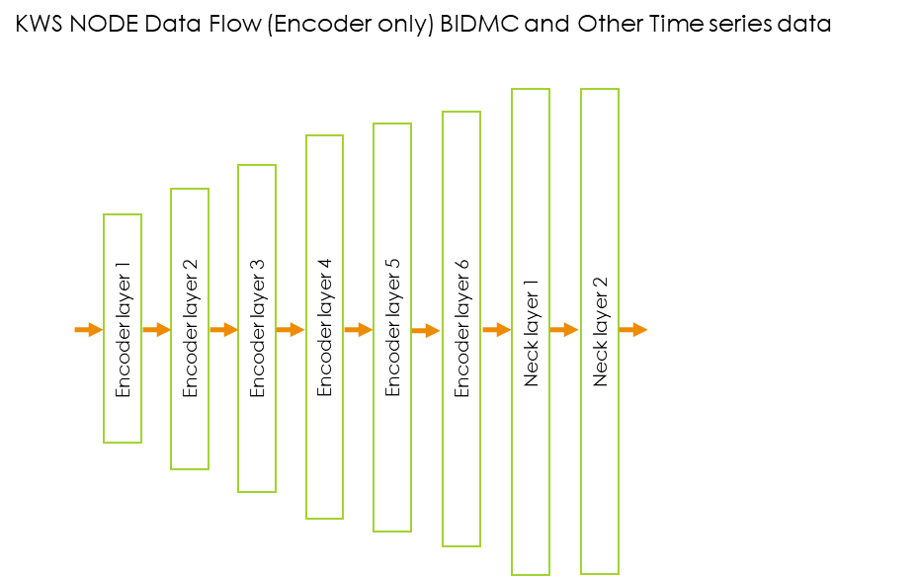

Akida Pico Development Tools - MetaTF
MetaTF is a complete Akida machine learning framework enabling the seamless creation, training, and testing of neural networks on the Akida Pico Processor. With MetaTF’s support for models created with TensorFlow/Keras and Pytorch, users avoid the need to learn a new ML framework while rapidly developing and deploying AI Applications for the Edge. Support for ONNX allows MetaTF users to leverage models developed in BrainChip’s TENNs compatible framework.
MetaTF supplies tools to convert a model with floating point weights and activations to a model with low bit-width weights and activations while maintaining model performance. These tools also convert quantized models trained using traditional deep learning methods to event-domain models for execution with low-latency and low-power on the Akida Pico Processor.
MetaTF provides the platform-agnostic Akida Runtime with a Hardware Abstraction Layer (HAL) for execution of models on Akida hardware. The Akida runtime also contains a software simulator for model evaluation without Akida hardware.
Speech Use Case Flow
The Akida Development Platform is the foundation supporting multiple AI Application development and deployment scenarios for users with different levels of AI expertise and network model customization needs. BrainChip supports a range of AI application development platforms - all of which ultimately deploy on the Akida event-based processing engine.
16 kHz Audio Input
Feature Extraction + Wake Word Detection
(KWS Model)
The QuantizeML & Compilation python packages provide tools to quantize Tensorflow/Pytorch models and convert models to the event domain for inference on the Akida Event-Based Processor Platform.
Data Flow for Key Word Spotting (KWS)
Options for AI Application Development and Deployment on the Akida Platform:
Low-code/No-code Tools for Limited AI Expertise
Native MetaTF for Customized AI Modeling
Turnkey AI Application Providers for Optimized complete applications
The steps to generate an Akida compatible model include:
Create & Train a Tensorflow/Pytorch model using standard development frameworks
Quantize (PTQ) a trained Tensorflow/Pytorch model using the QuantizeML toolkit
  Optional QAT to maintain maximum performance
Compile a model to Akida format using the CNN2SNN toolkit
Model Library for reference NNs with performance data
V2.1 February ‘26
BrainChip Inc. ©2026
www.brainchip.com
23041 Avenida de Carlotta, #250, CA 92653
T: +1 949.784.0041

